Slide 1
D.C. Bar Lawyer Assistance Program
Presents
Clearing Clutter:
Tuning in to Time, Space and Mind
Niki Irish, LICSW, Senior Counselor, LAP
Yvette Mitchell, LICSW , Senior Counselor, LAP
D.C. Bar LAP 202-347-3131

Slide 2
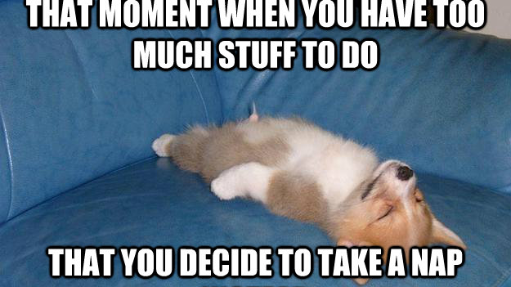
Notes:
The catch: I don’t feel like I have the time/energy to do this but not doing this saps your time/energy

Slide 3
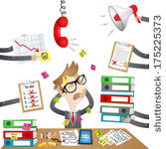
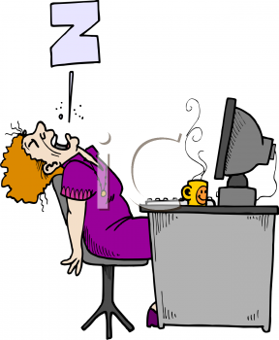
Why are you here today?
What are your barriers to organization?
  Not enough time
  Too much work
  Competing demands
  Low energy
  Too overwhelmed
  Lack of resources
Notes:
Why do you want to declutter? (connect w/ this to keep motivated) -
What is working? Not working?
What would you like to work better? What would you like to be different?
Write down

Slide 4
Objectives
Begin to identify your own values and priorities
Identify your personal organizational hurdles and pitfalls
Identify what benefits decluttering can bring to your practice and personal life
Learn new tools and techniques to help with better managing your time, space, and mind
***Disclaimer: Not all tools and techniques will work for each of you. The goal is to start practicing awareness of what works for you.
Notes:
Difference pieces of advice will resonate differently for everyone. Knowing yourself is key before all else.
Obj 1 – Identifying our own values may seem like a no brainer, but sometimes it’s not that easy to do, or we find that we have forgotten what our core values are, because we are all moving at a warp speed.
Obj. 2 – During this session, try to use this time to hone in on what your personal barriers to organization have been. Be honest with yourself!
Obj. 3 – Use this session as a way to reframe decluttering – instead of looking at it as an insurmountable task, look at how decluttering can improve your overall wellbeing
Obj. 4 – Walk away with a few action steps that can help get the decluttering ball rolling.

Slide 5
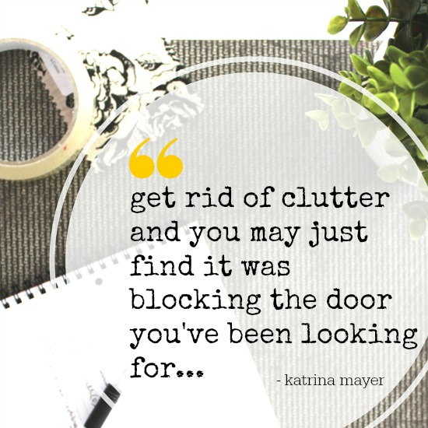
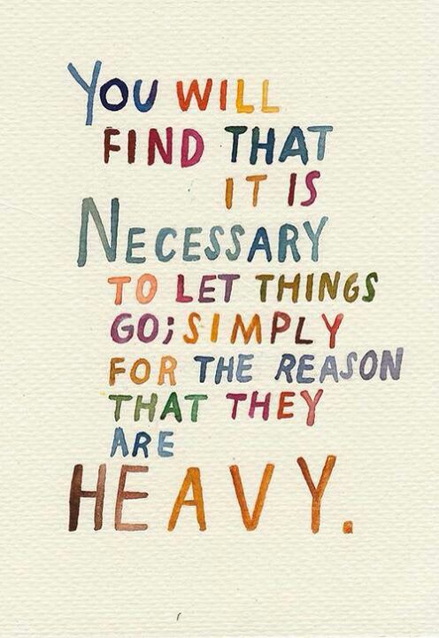

Slide 6
Glossary
Clutter
  Verb: To run in disorder. To fill or cover with scattered or disordered things that impede movement or reduce effectiveness.
  Noun: A state of noisy, confused activity
Time management –
  The ability to plan and control how you spend the hours in your day to effectively accomplish your goals.
Space (Physical and Virtual/Digital)
  The amount of an area, room, surface, etc., that is empty or available for use
Mind
  The element of a person that enables them to be aware of the world and their experiences, to think and to feel.
  A person’s attention.
*Merriam Webster, https://www.merriam-webster.com/dictionary
Notes:
“Clutter is the physical manifestation of unmade decisions fueled by procrastination.” ― Christina Scalise
“Clutter is not just the stuff on your floor…Its anything that stands between you and the life you want to be living” – Peter Walsh
“Anything in our lives that no longer serves us.” - Brooks Palmer - About asking yourself whether or not you like something now. Indecision is a red flag – it means a part of you is saying no to this thing.

Slide 7
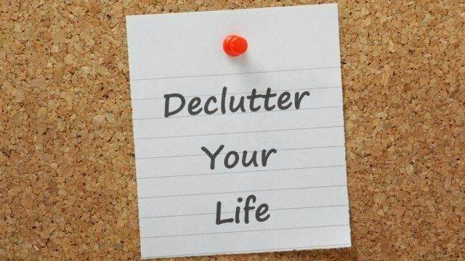
Why Bother?
NIH study
  Increases productivity
  Decreases irritability
  Decreases distraction
Notes:
Professionally, time is money, and you want to be as productive and efficient as possible. Clutter gets in the way of that goal. Transitioning/Searching kills time and productivity and flow.
Clutter is the out of control feeling. Anxiety. Tension. Goal is to declutter so feel more control, freer, less weighed down.
We need open and unencumbered space inside and out just as much as we need food and sleep.

Slide 8
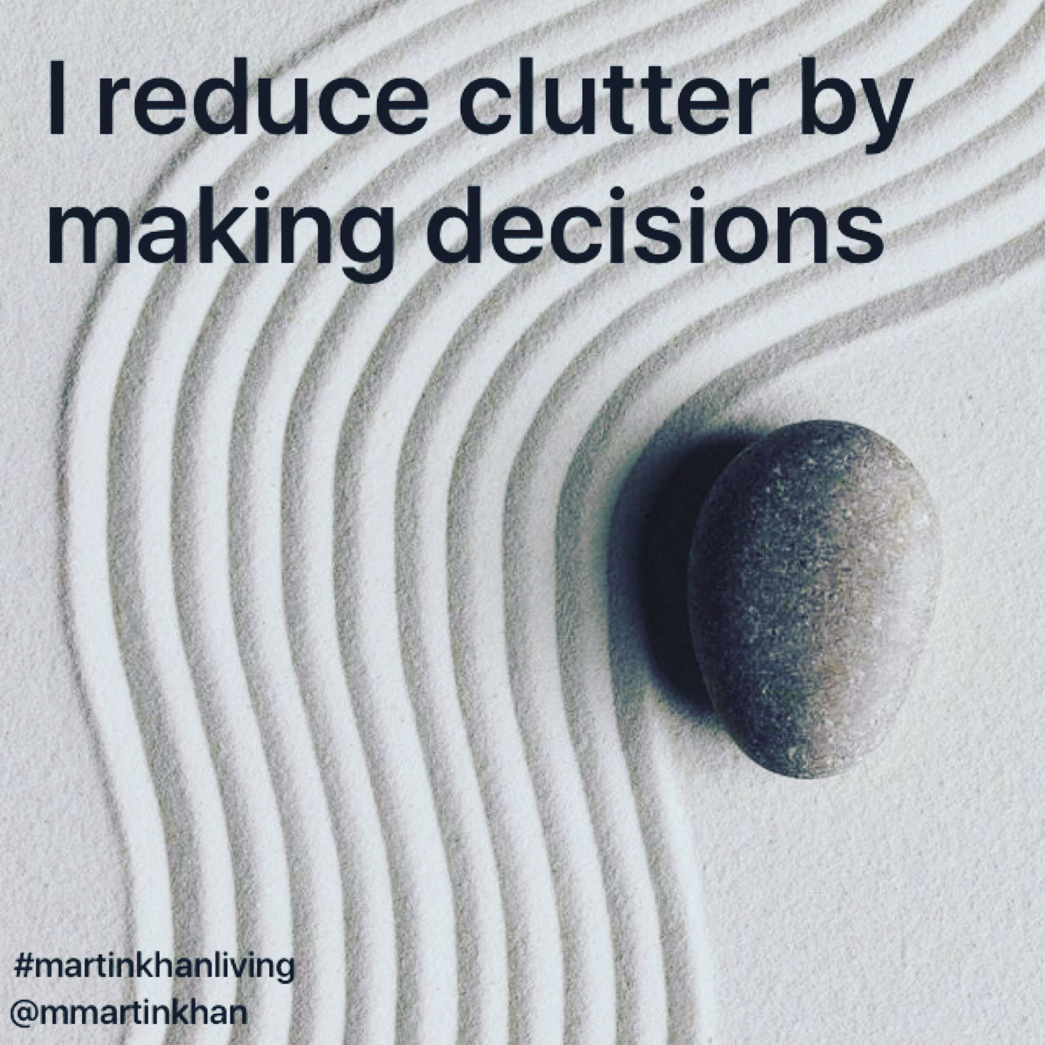
Identifying Priorities & Values
Values: “something (such as a principle or quality) intrinsically valuable or desirable”*
Priority: a thing that is regarded as more important than another
*Merriam Webster, https://www.merriam-webster.com/dictionary/value
Notes:
You can buy container after container and make all the to-do lists you want, but if you don’t take hold of why you are cluttered, it will never change.
Not about balance but rather attempts at prioritization. Makes decision making easier. And a lot of clutter is about putting off making a decision.
It takes wisdom and courage to build your life around answers to “what is really important?”

Slide 9
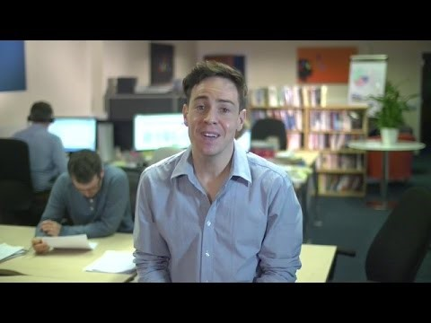
Values
https://www.mindtools.com/pages/article/newTED_85.htm

Slide 10
Values
Authenticity | Fame | Peace
Achievement | Friendships | Pleasure
Adventure | Fun | Poise
Authority | Growth | Popularity
Autonomy | Happiness | Recognition
Balance | Honesty | Religion
Beauty | Humor | Reputation
Boldness | Influence | Respect
Compassion | Inner Harmony | Responsibility
Challenge | Justice | Security
Citizenship | Kindness | Self-Respect
Community | Knowledge | Service
Competency | Leadership | Spirituality
Contribution | Learning | Stability
Creativity | Love | Success
Curiosity | Loyalty | Status
Determination | Meaningful Work | Trustworthiness
Fairness | Openness | Wealth
Faith | Optimism | Wisdom
Notes:
Take a look at this list of values. Take a moment to review this and then circle all of the values that resonate with you.
Utilizing the recommendations from the video, consider:
Think of a time when you were happiest. What were you doing and why were you so happy?
Think of a time when you felt proud, why did you feel so proud?
Think of a time when you felt fulfilled.
Think of a list of values that led to these outcomes. What need or desire did you meet to reach your outcome.
Identifying your personal and life values can help give you a blueprint to reference when you are making decisions. By following your values this can lead to a happier less stressed life.

Slide 11
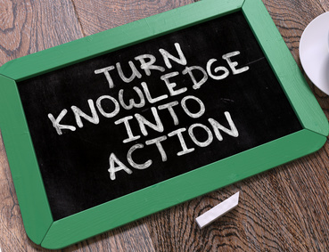
Values in Action
How to implement changes in
  your office setting,
  your schedule,
  your mental space.
Notes:
Now that you know why you want to make changes, lets look how some tips and techniques to help actually make/implement the changes you want and need.

Slide 12
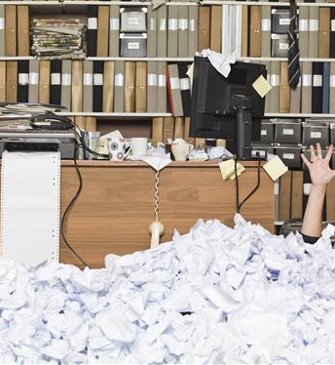
Decluttering
Office Space
Start with an assessment of what you want and need.
  Visualize how you want to use the space.
Divide your workspace into zones
  Workspace for computer. Library for research. Storage for supplies. Filing area for archives.
Set limits on the amount of “stuff” you will tolerate
  Allow one bookshelf, if its full it is one book in, one book out.
Keep only what you need at arm’s length.
  Only essentials are allowed on desktop. Supplies, paperwork, etc should be kept in the zone you established for them.
Sort your junk drawer
  Use draw dividers and compartments to give everything a home
Have a basket/drawer for short-term storage
  You will probably have overflow. Give it a home and clear it routinely.
Notes:
Remember, the why do you want to clean is essential (it helps break the pattern)! Know what you want. How do you want the space to look and function? What do you use daily? What are the distractions?
Designate a drawer for personal items, briefcase, shoes, purse, coat etc that is out of the way visually. The top drawer next to your dominant hand should be for daily use only.
Searching for things = time and energy wasted.

Slide 13
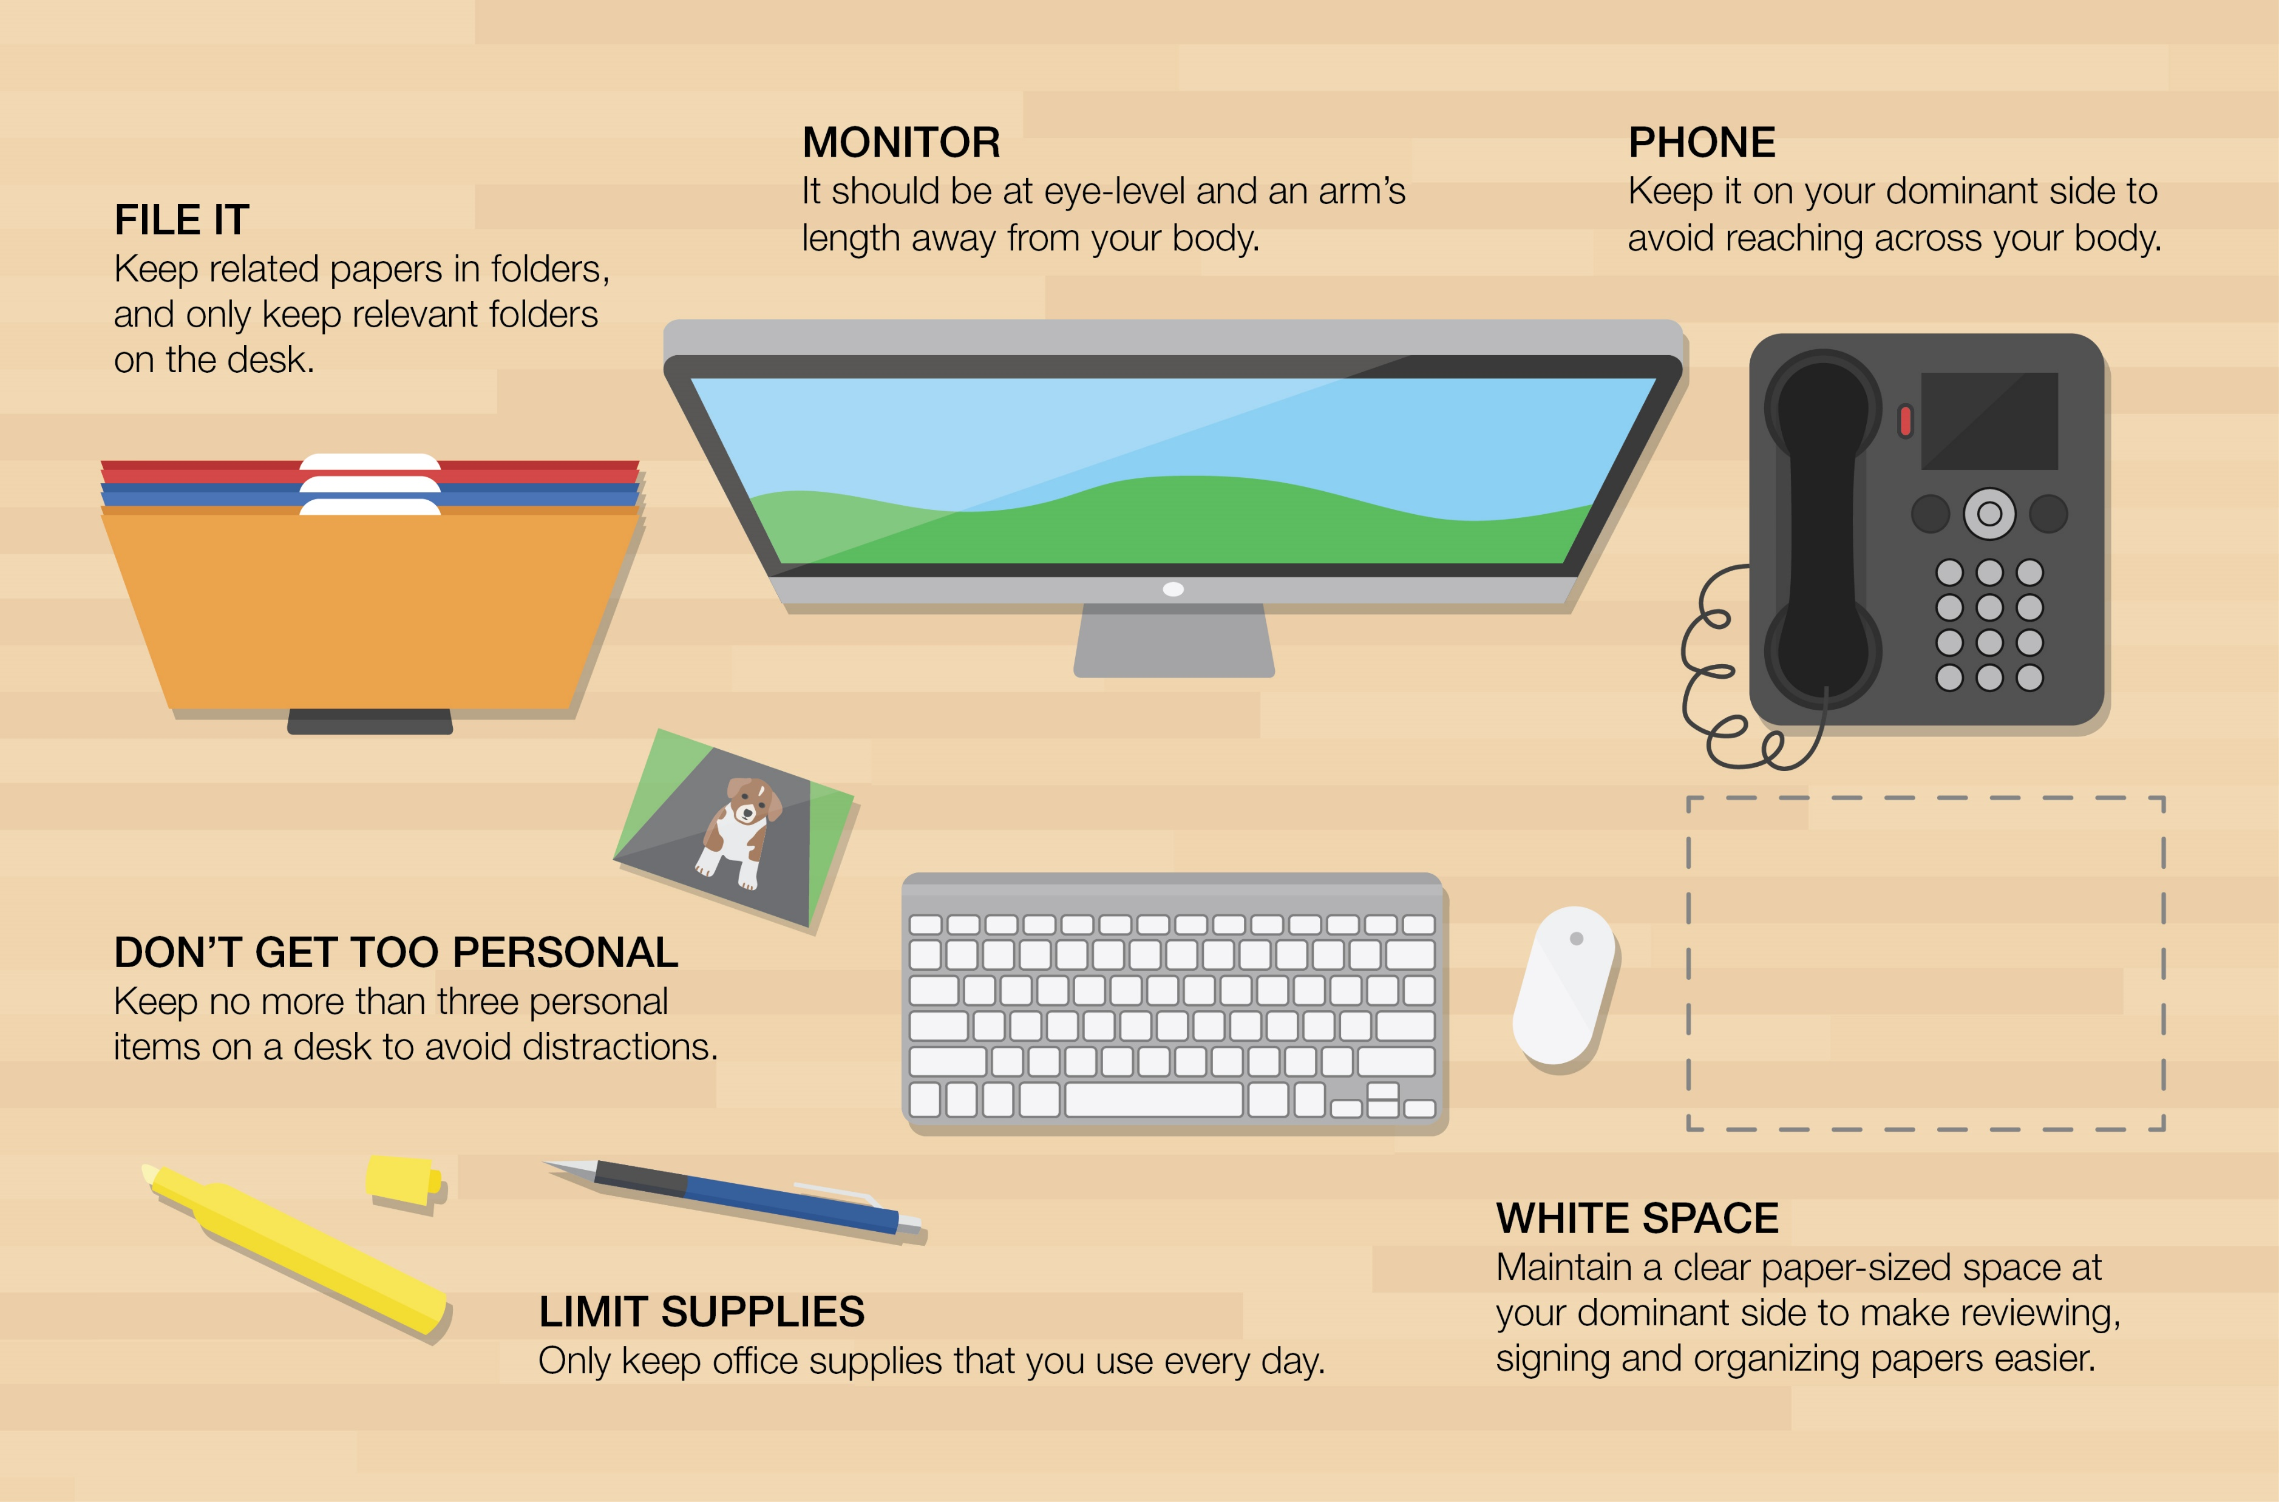
Office Clutter: Tips and Techniques
Get rid of paper.
  Toss as much as possible.
  Scan everything you can, including business cards and meeting notes.
  Ensure you are receiving electronic notifications/bills where you can.
  File what is left.
Create (and use) a daily paper system.
  Active. Action. Archive.
  To do. To File. To read.
Make sure your personal items have a home.
  Have a drawer, a basket, hooks on the wall for storage.
Spend 5 uninterrupted minutes at the end of every day, maintaining your systems.
Disinfect regularly.
  Wipe everything down once a week. It will force you to clean up potential clutter. Put it on your calendar!
Notes:
Paper system – you may need to gather all your papers and put them on the floor. Grab a cup of tea and start sorting. Purge as many as you can. Ask yourself, is there any chance I may look at this again? Where do it put it so I find it easily?
Per the WSJ we waste on avg 55 minutes a day looking for documents we own.
Papers – schedule time in your day to take care of the paperwork clutter. Don’t leave things in the “to read” pile for more than two weeks.
Repeat daily. 5 minutes. To maintain. Give yourself 5 solid minutes. If you give yourself focused, uninterrupted 5 minutes to sorting one pile of junk, it will make a huge difference. Don’t underestimate how a few minutes can add up over time.
¾ of workers say a clean office makes them more productive

Slide 14
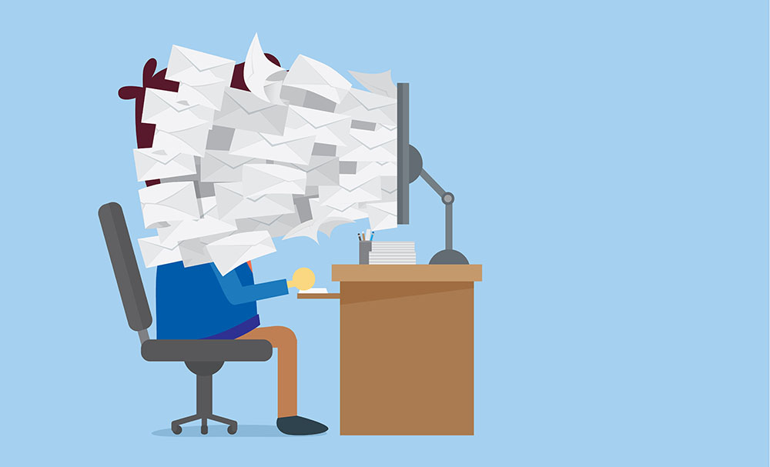
Digital Decluttering
Notes:
Challenge of digital clutter is that no one else sees it or calls you out on it. Its hidden clutter. Therefore, can be less motivating to change it, no external pressure.
It still creates stress though. Not being able to quickly and easily find what I want/need. You will feel more “at ease” when you know where things are.
Documents. Photos. Apps.
Reminder: technology is designed to be addictive. To give you that hit of dopamine so you keep using it, checking it, wanting more. It creates a challenge in focus. We can lose our ability to sustain focus, do deep work, pay singular attention and tolerate boredom

Slide 15
Digital Clutter: Tips and Techniques
Tame your information overload
Remove distractions.
  Turn off email notifications on your phone and computer.
  Remove social media alerts.
Organize your documents.
  Delete multiple iterations
  Archive if afraid to purge
  Folders are your friend
Streamline desktop icons and phone apps.
  What are the five essentials you need?
  Place icons/apps in folders
Purge apps and photos.
  If you haven’t used the app in three months, get rid of it.
  Think about what moment you are trying to capture and only keep those that do.
Simplify social media regularly
  Know what you want to get out of your social media use.
  Unfollow/alter feeds to suit your current interests.
Set boundaries with email and phone calls.
  Have a set period to check during the day. Trust emergencies will find you.
  If it is going to take less than 5 minutes, respond immediately.
  Filter. Create a “rule” to move emails automatically to folders
  Unsubscribe ruthlessly.
Notes:
The beauty of technology is that everything is searchable so it just needs to have a general home, don’t get to intense. Keep it simple!
A cluttered screen triggers stress
UC Irvine study of IT and Accountants showed they switched eveyr 10.5 minutes per project and were interrupted more than half of that time. It takes 23 minutes to reorient yourself to the task at hand.
Deal with an item as few times as possible. Complete minor tasks immediately to avoid ending up on a to-do list or a stack of papers
Delete and discard.
Find 5 things every day to discard.

Slide 16
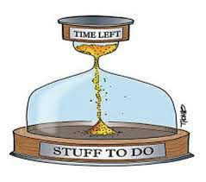
Addressing Time Clutter
  Be intentional. Own your time unapologetically.
  Be realistic about time per demand
  Know your priorities and values
  Rank and organize demands accordingly
  Identify and enforce boundaries
    Work. Family/Friends. Personal. Social media.
“You can do anything, but you can’t do everything”
-David Allen
Notes:
Must think about values and priorities when organizing daily tasks.
Its about demands on our time, a commitment to complete an action in the future. When there is “clutter” if our time, when demands are not properly managed they weigh on our mind, disrupt our attention. We focus on the uncompleted task vs completed one.
Resistance often comes from habituation, we’ve used the systems for years/decades and we are faced with gaps in the system as demands increase. We have to actually stop and assess before being able to move forward with a plan. Otherwise gaps will continue. Organizing our time has to be self-directed. Develop own goals. ---Have them write down: What is and is not working? What do you want to work better?
Learn:
To stop multitasking
You cant do it all
The skill of saying “no”
The art of delegation, automation, outsourcing

Slide 17
Time Clutter: Tasks
Upgrade your Task List
Decide on your top 5 priorities. Not just at work but in life.
Write down any and all tasks and organize under the priorities.
Identify tasks that require focus as “Think work” and quick tasks as “Action items”
Schedule time on calendar for both types of work
  i.e. Ensure chunks of quiet, uninterrupted time for “think work”
Organize your list both weekly and daily.
  Every Friday set aside time to prepare for week ahead.
  Move items from weekly to daily at the end of each day. (Remember to be realistic and intentional).
Now to shorten the to-do list.
Highlight all the items you dread doing.
Delete or delegate as many of these items as possible.
  Acknowledge the emotions you feel and what you have to let go of (a fantasy version of you)
Transform anything highlighted left on the list into something you actually want to do.
  Try pairing a not-fun task with something you want to do more of.
  Tie the tasks with what their importance or significant is in relation to your priorities.
Research shows making a plan to deal with unfinished tasks makes a huge difference in our ability to focus.
Notes:
Move away from “fire fighting”
Have an agenda for phone calls. Stick to a time limit.
Some studies show 23% of work day is spent checking email. Email is just a giant to-do list that other people create for you. It gives us a false sense of productivity
Make a prioritized list at the end of every day
Three items per day on a “Daily Action” List. The most important ones focus on them until they are finished. The longer to do list is for future planning.
Having a plan removes/reduces worry. Its not the “what” I have to do but the “when” I am going to do it.

Slide 18
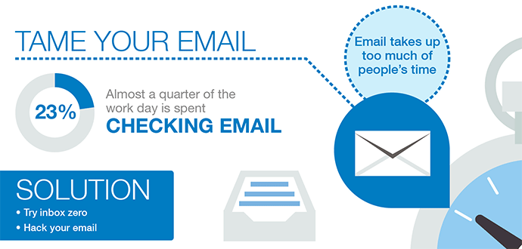
Time Clutter: Emails
Fact: Time clutter and email are intertwined.
Screen all calls and emails.
  Reminder: Turn of all alerts
  Schedule two or three specific times to respond.
Have separate email accounts
  Work only
  Personal – family and friends, invitations, school events, etc
  Bulk – subscriptions, newsletters, social media notifications,
Relentlessly unsubscribe
  If you haven’t read it or enjoyed it in the past three months it goes
Reduce email/call exchanges regarding scheduling meetings
  Try software such as Acuity scheduling
Work towards inbox zero daily

Slide 19
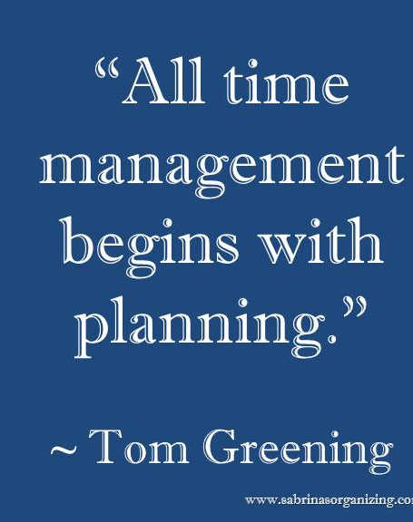
Time Management Techniques
  ABC analysis
    ranks tasks from urgent to unimportant
  POSEC method
    Prioritize by Organizing, Streamlining, Economizing and Contributing
  WADE
    Write it down. Add it up. Decide. Execute.
  Pomodoro Technique
    25 minutes of work. 5 minutes of break time
  GTD (Getting Things Done)
    Finish small tasks immediately and divide big tasks into smaller tasks to start completing now.
Notes:
This is a reference slide for further research on your part. Start googling.

Slide 20
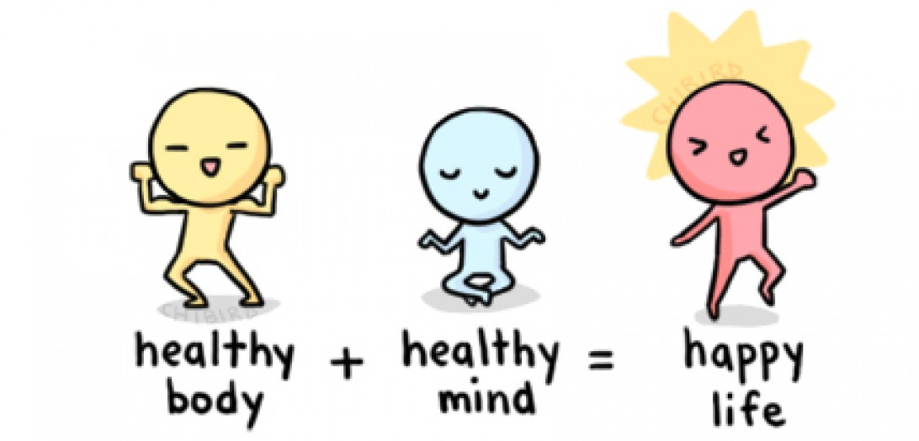
Techniques for Decluttering the Mind & Body
Notes:
This section is looking at how you can take steps to declutter your mind and body. As we look at the mind and body, we are suggesting that you focus on your physical health, mindfulness practices, and your thinking patterns.
Mindfulness - the practice of maintaining a nonjudgmental state of heightened or complete awareness of one's thoughts, emotions, or experiences on a moment-to-moment basis; also : such a state of awareness
Physical exercise and mindfulness practices help to improve your cardiovascular health, as well as calm your central nervous system. When these systems are operating more effectively, you may find that your mood improves, which can impact your productivity.
Mindfulness assists with helping you to pause. Pausing – raising awareness of body and feelings?
Being aware of your negative thoughts patterns can also be effective when trying to declutter your mind. Begin to practice awareness of thoughts such as “I’ll never get all of this done!” or “This isn’t good enough!” Engaging in negative thought patterns takes your time, energy, and can reduce your productivity.

Slide 21

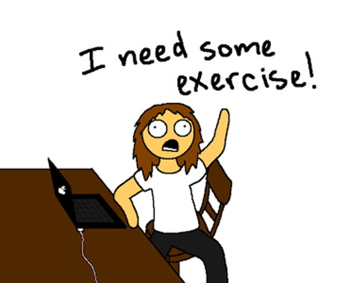
Decluttering the Body
Stretching/Yoga/Exercise
    Nutrition
    Sleep hygiene
Notes:
Research has shown that meditation can actually change your body:
Your brain releases happy chemicals – You get a boost of serotonin, dopamine, and endorphins, which are all linked to a good mood.
Your blood pressure drops – a Medical College of Wisconsin study showed that people who meditated twice a day for 20 minutes lowered their blood pressure.
Digestion is better – Stress can trigger stomach discomfort

Slide 22
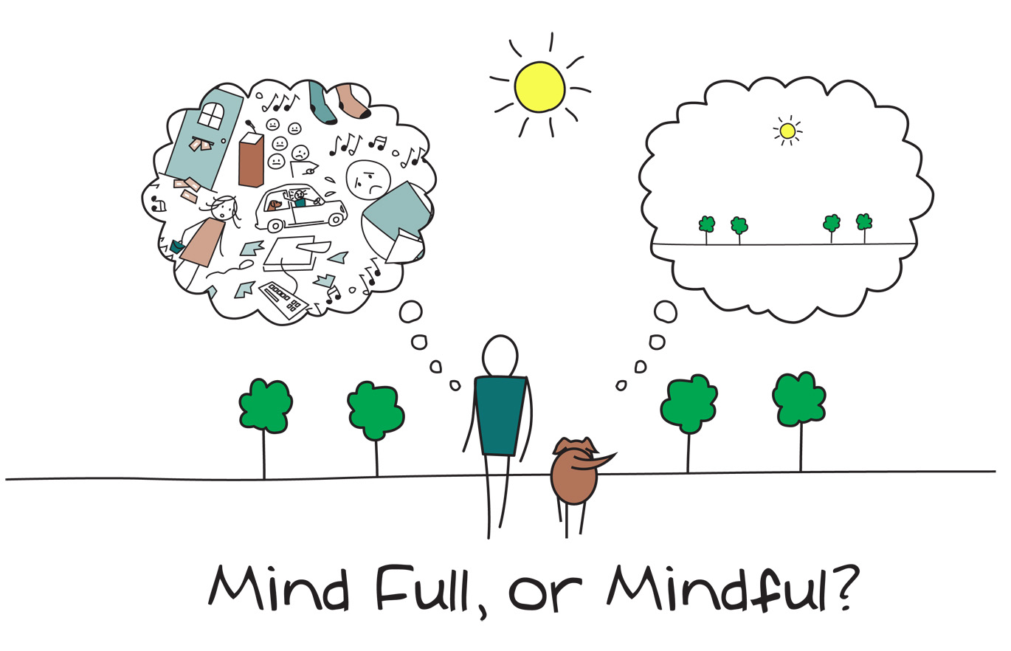
Decluttering the Mind
Mindfulness Skills:
Deep breathing
Body Scanning
Meditation
Notes:
Meditation – including guided imagery

Slide 23
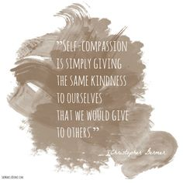
Decluttering Thoughts
Cognitive Practices
Self-compassion
Reframe negative thoughts
Identify a mantra
Notes:
Be aware of the self-criticism that you participate in daily.
Mantra – Remind yourself of your goal and/or the purpose. “One small step at a time.” Choose a mantra that is logical and meaningful to YOU.

Slide 24

Set Goals
Break down your goals into specific tasks and plans of action.
Create a checklist.
Periodically review and revise your goals, as needed.
Keep goals visible.
Identify an accountability partner.
Notes:
Use a white board, post it,

Slide 25

Rules to Remember
It is a continual process. You will have setbacks and/or return to old patterns. That’s ok!
Sacrifices will need to happen.
It takes ongoing awareness and practice to make progress.
This will feel uncomfortable. Become comfortable feeling the discomfort. This is new.
Notes:
You will have to sacrifice time at work to exercise.

Slide 26
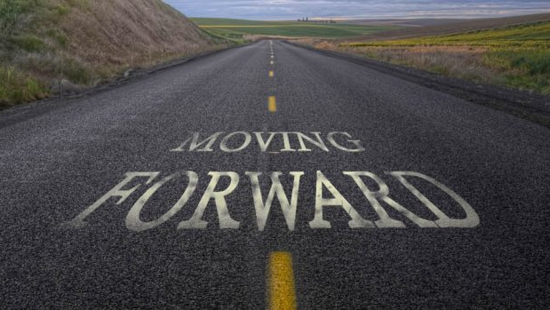
What do you think?
What is the first action step you will take?
Notes:
Look at the values that you circled.

Slide 27
D.C. Bar LAP Services
Assessment, evaluation, referral, short term counseling and support/follow up, monitoring.
Access to a LAP volunteer who is trained and understands what a person is experiencing.
Consultation with firms or other concerned parties about possible interventions.
These services are free and confidential to D.C. Bar members, Judges and Law Students in the District of Columbia.
Call 202-347-3131

Slide 28
Sources
Alvim, S. (2017, April 29). The Real Definition of Clutter [Blog Post]. Retrived from http://www.huffingtonpost.com/sofia-alvim/the-real-definition-of-clutter_b_9791568.html
Carter, C. (2016). How To Gain An Extra Day Each Week. Retrieved from https://courses.christinecarter.com/gainanextradayebook/.
Pfeifer, W. (2017, April 8). Essential Time Management Tips for Lawyers [Blog Post]. Retrieved from https://www.thebalance.com/effective-lawyer-time-management-2151357
Schulte, B. (2015, January 6). How to Organize Your Desk to Do Your Best Work. Washington Post. Retrieved from https://www.washingtonpost.com/.

